Slide 1

MTA Navigator

Slide 2

Project Overview
• Intelligent chatbot for NYC Subway system
• Plans trips, provides real-time arrivals, reports service alerts
Built using FastAPI, NetworkX, SQLite, and OpenAI GPT-4o mini
• General Transit Feed Specification is a standard format transit agencies use to share data. It Integrates GTFS static and real-time data.

Slide 3
Client Layer
Simple HTML/CSS/JS interface
Sends chat messages via REST API
Renders Markdown using marked.js
Generates unique session_id for each user session

Slide 4
API Layer (FastAPI)
Main endpoint: POST /chat
Input: message + session_id
Maintains conversation history in memory
Forwards prompt to GPT-4o mini with tool definitions
GPT-4o mini decides whether to call tools or respond directly

Slide 5
LLM Orchestration (Function Calling)
• Tools exposed to GPT-4o mini:
– plan_trip
– get_next_trains
– get_alerts
• GPT-4o mini selects tools based on intent
• Ensures Probabilistic, structured responses
• Reduces hallucinations via StationService confidence scoring

Slide 6
Service Layer Overview
Key services include:
• StationService: fuzzy matching for station names
• GraphBuilder: constructs routing graph using NetworkX
• Routing: shortest path via Dijkstra Algorithm
• Real-time services supporting train arrivals & alerts

Slide 7
StationService Details
• Loads all station names into memory
• Uses fuzzywuzzy for resolving user inputs
• Returns station_id + confidence score
• Handles ambiguous names by prompting user

Slide 8
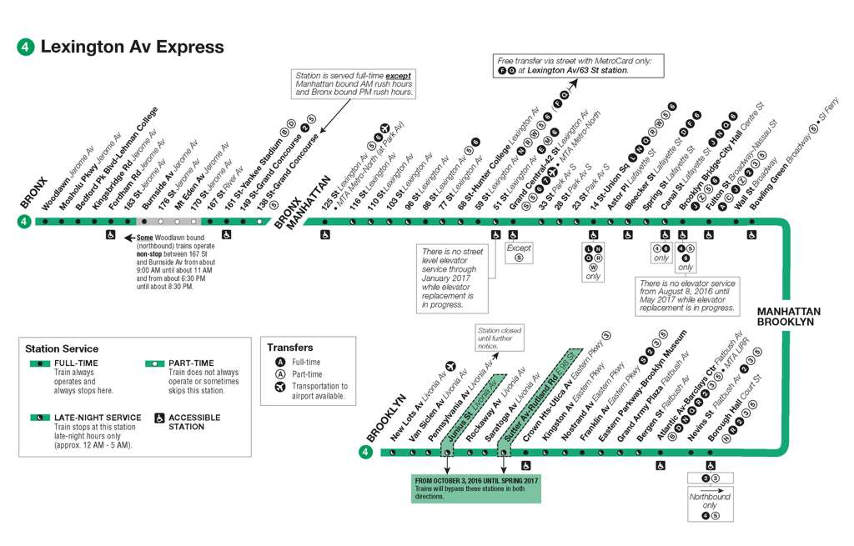
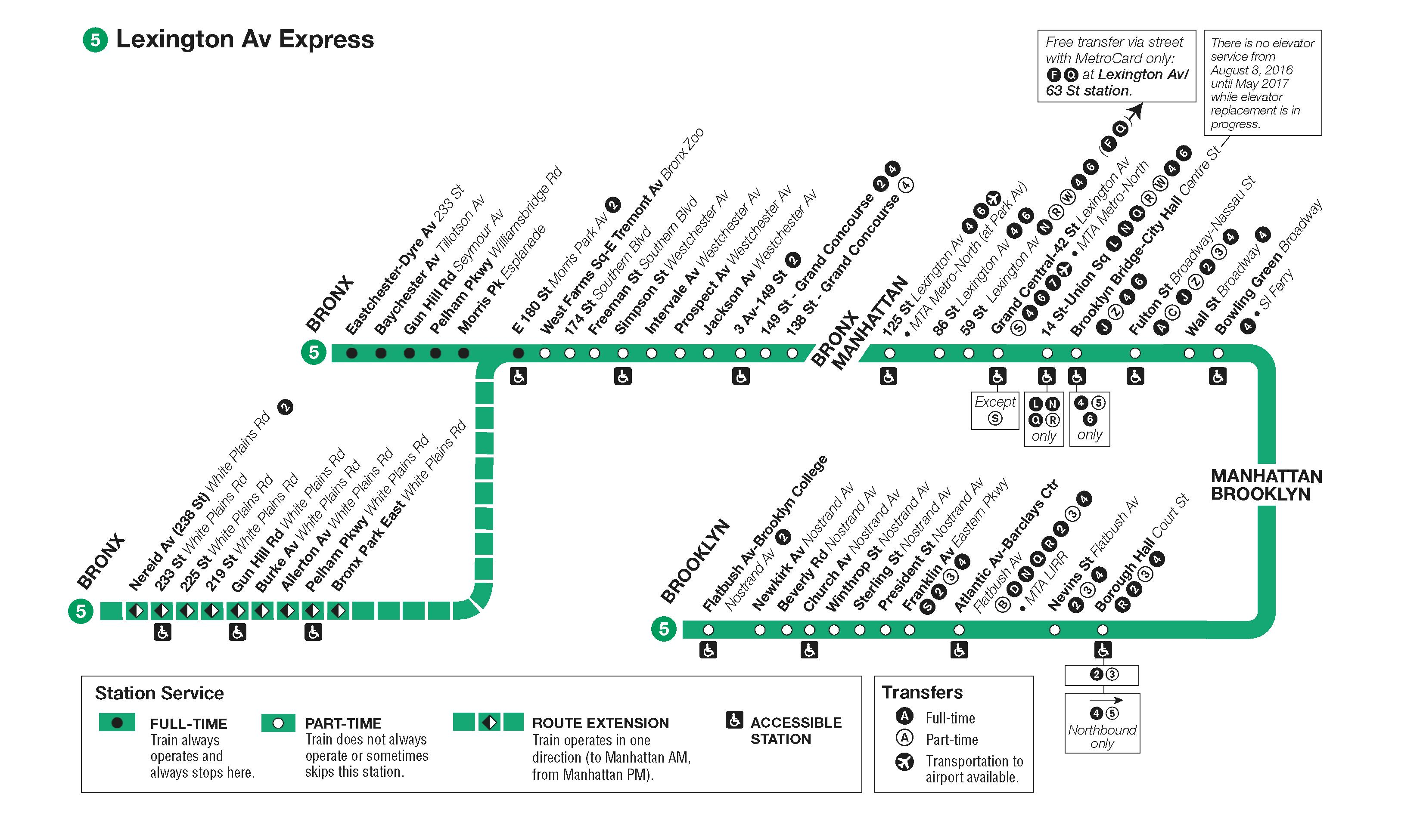
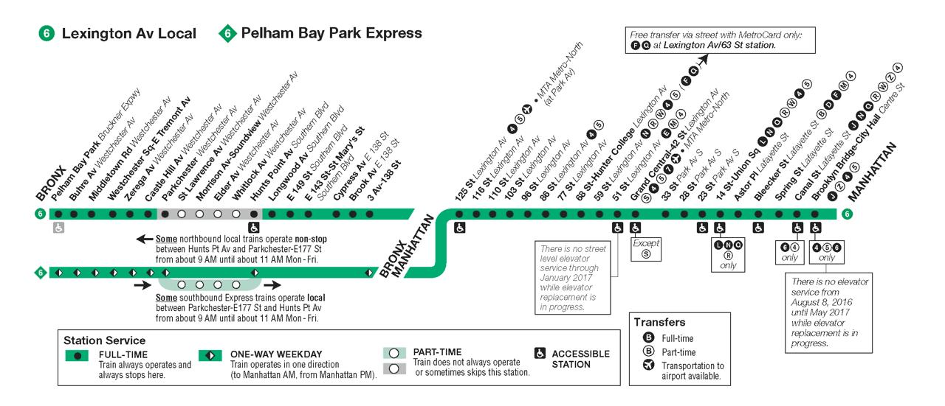

Slide 9

GraphBuilder Details
• Builds directed weighted graph using GTFS
• Node structure:
– Parent stations
– Child platforms
• Edge types:
– TRACK: movement between stations
– TRANSFER: walking connections between lines
– STATION_PATH: links parent to children

Slide 10
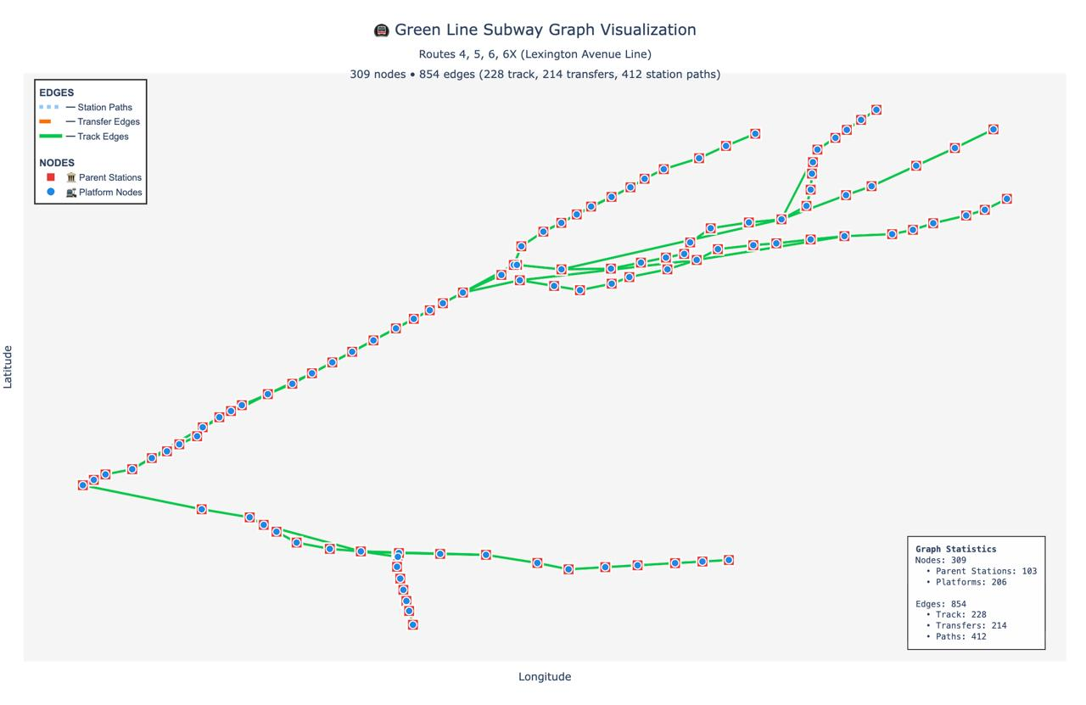

Slide 11
Routing Logic
• Uses NetworkX Dijkstra algorithm
• Computes fastest path using weighted edges
• Outputs full itinerary including:
– Line changes
– Transfer times
– Station-to-station sequence

Slide 12
Data Layer - Overview
Consists of static GTFS + real-time data:
• SQLite DB storing stops, routes, trips, stop_times
• real-time buffers: realtime_updates & realtime_alerts
• Ingestion scripts for static GTFS
• Background worker for MTA real-time feed

Slide 13

System Architecture
The system consists of the following layers:
1. Client Layer: HTML/JS frontend
2. API Layer: FastAPI backend handling chat requests
3. LLM Orchestration: GPT-4o mini with function calling (tools)
4. Service Layer: Station matching, graph routing, itinerary logic
5. Data Layer: SQLite + ingestion + real-time buffers

Slide 14

CHATBOT DEMO

Slide 15

Thank you!

